Slide 1
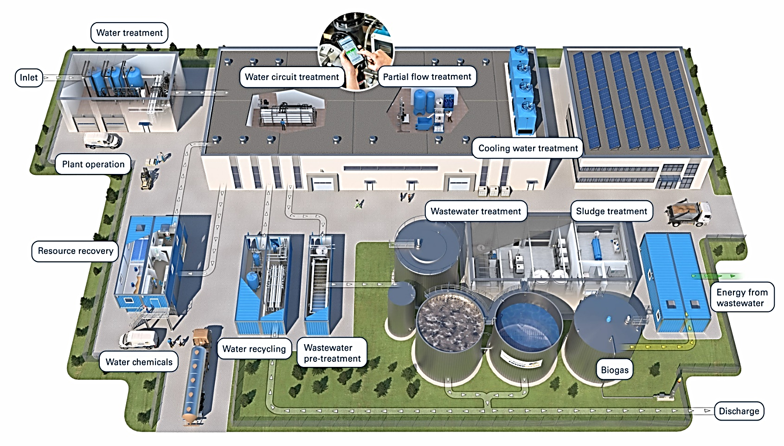
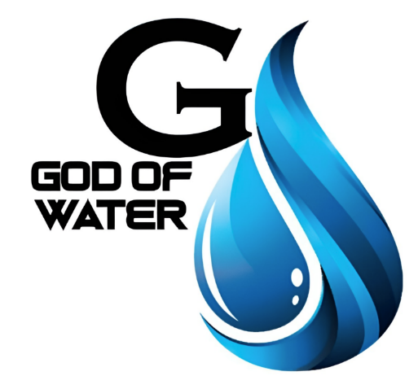
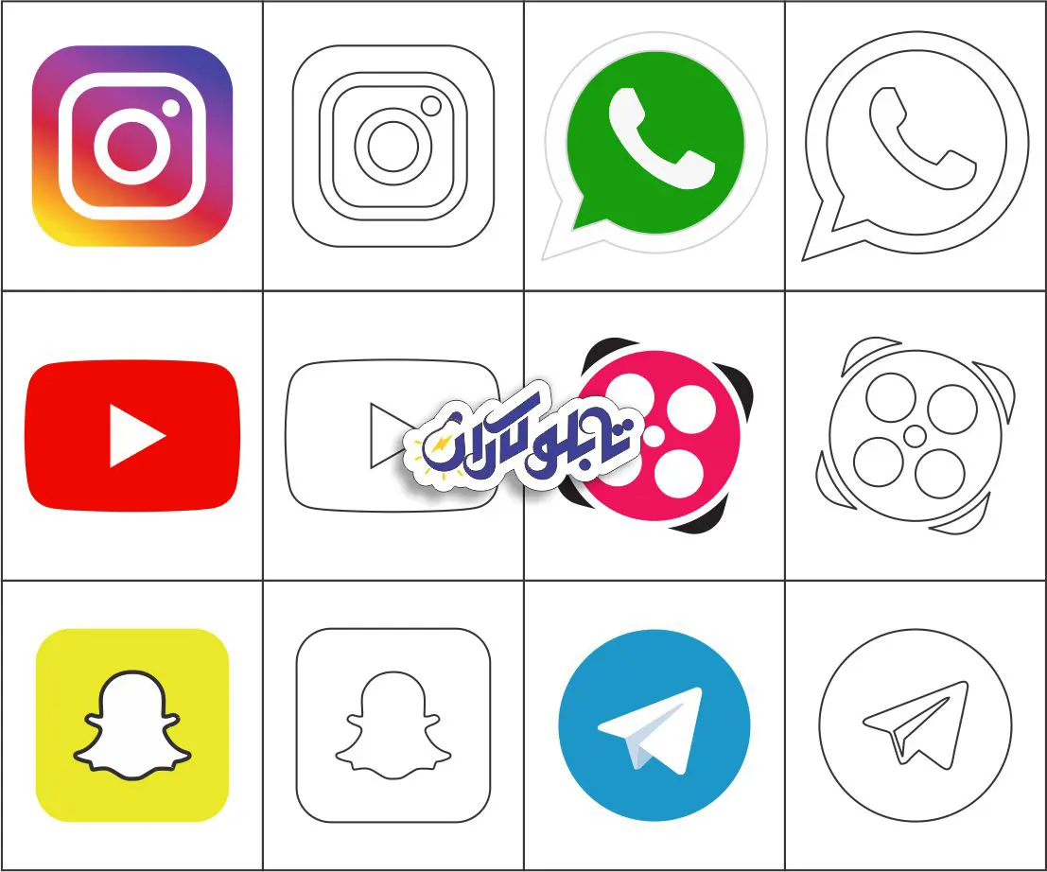
Web: WWW.GW-company.com
WWW.GW-company.ir
Email: info@GW-company.com
Admin@GW-company.com
Contact us: +982144455965
+989124173691
+989122148067
gw.industry

Slide 2

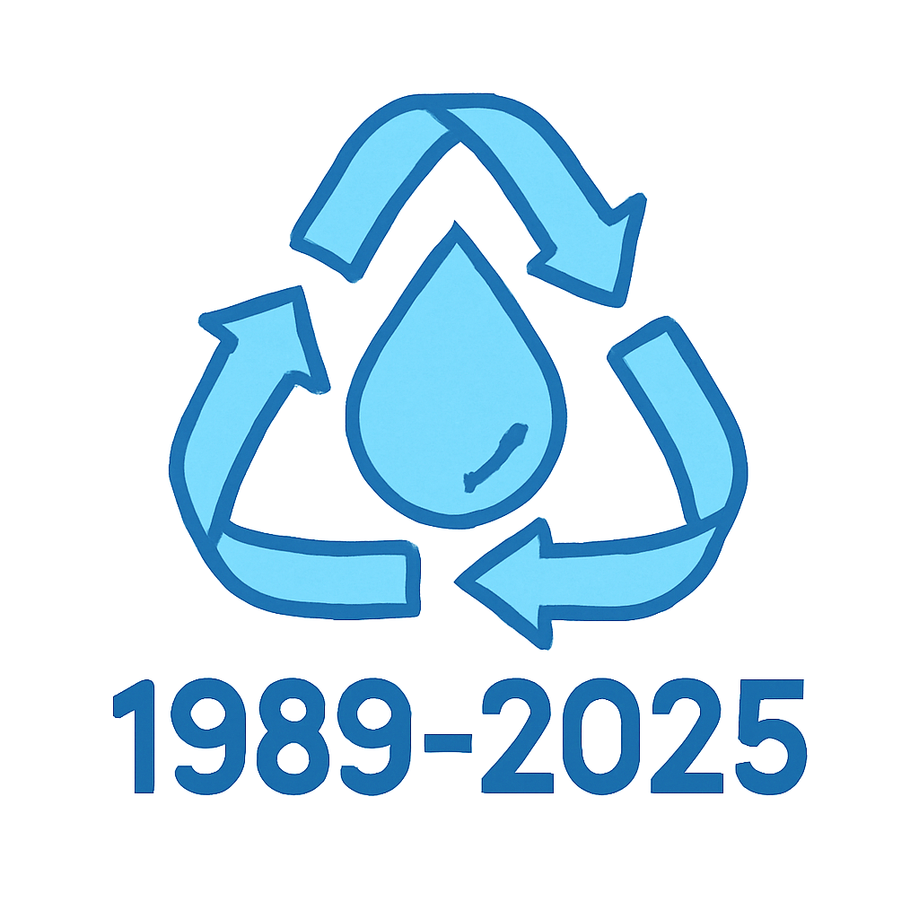

About Us
GW Engineering Company was established for the first time in 1990 with the goal of purifying surface and groundwater. It began its activities by studying, designing, and constructing various water and wastewater treatment plants (both pre-assembled packages and on-site installations). Through the foresight of its managers and the continuous efforts of its staff, and after more than four decades of experience, the company has taken strong and steady steps in this field and is now considered one of the well-known brands in the water and wastewater industry. The company has successfully implemented thousands of large and small projects across the country.

Slide 3
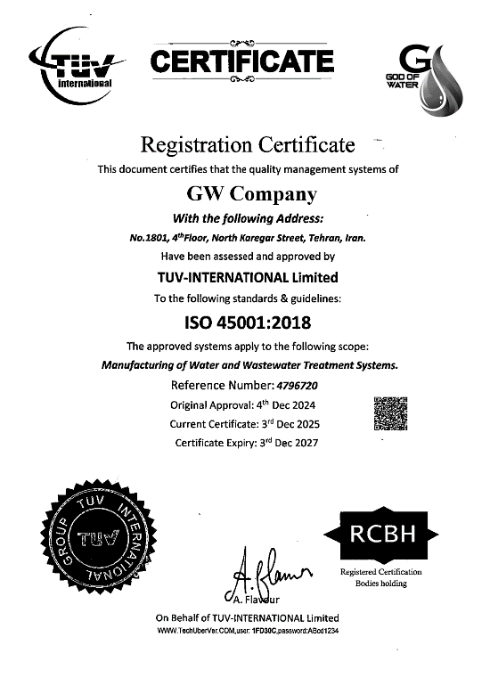
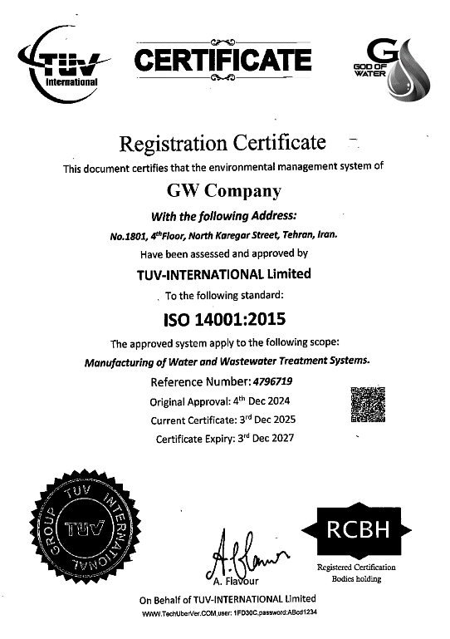
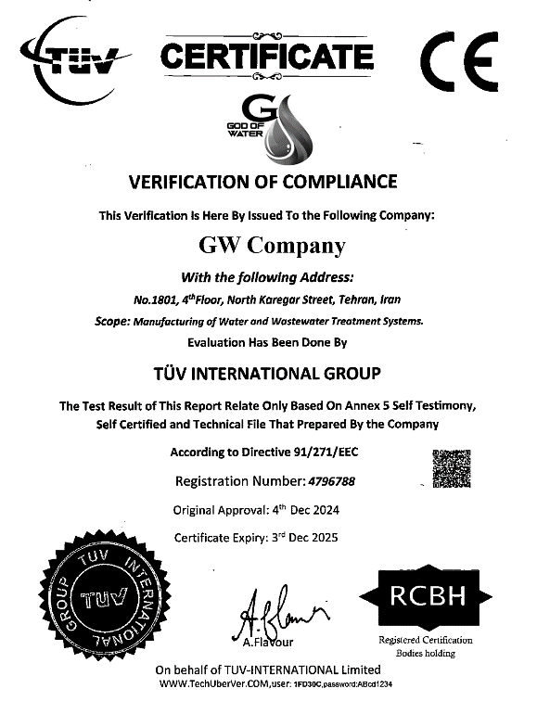
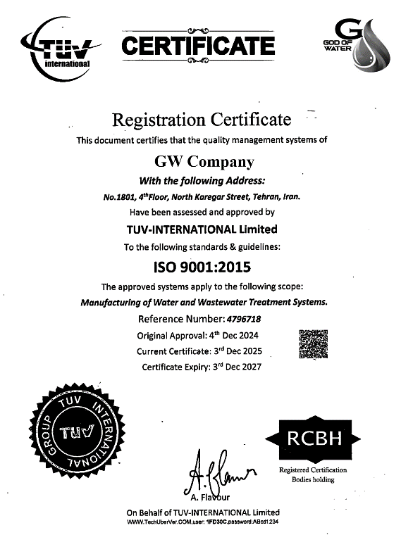
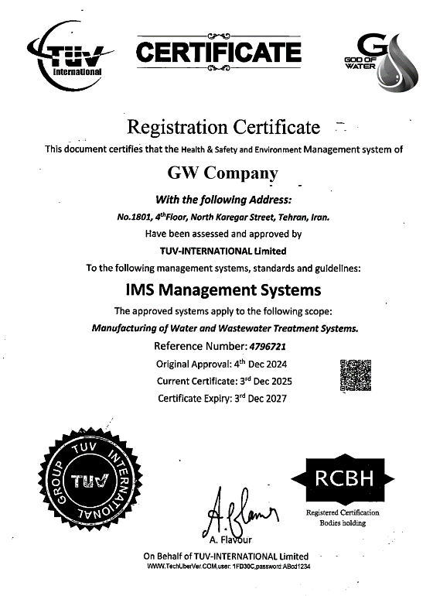
ISO

Slide 4
Water Treatment Systems
Sewage Treatment System
Reverse Osmosis
Sand Filter
Water Softener
Chlorination
Ozone Generator
Water Treatment Equipment
Septic Tank
Pumping Station
Grease Trap
ASBR (Anaerobic Sequencing Batch Reactor)
MBBR (Moving Bed Biofilm Reactor)
A2O (Anaerobic, Anoxic, and Oxic Process)
Gray Water Treatment

Slide 5
Sewage Treatment System

Slide 6
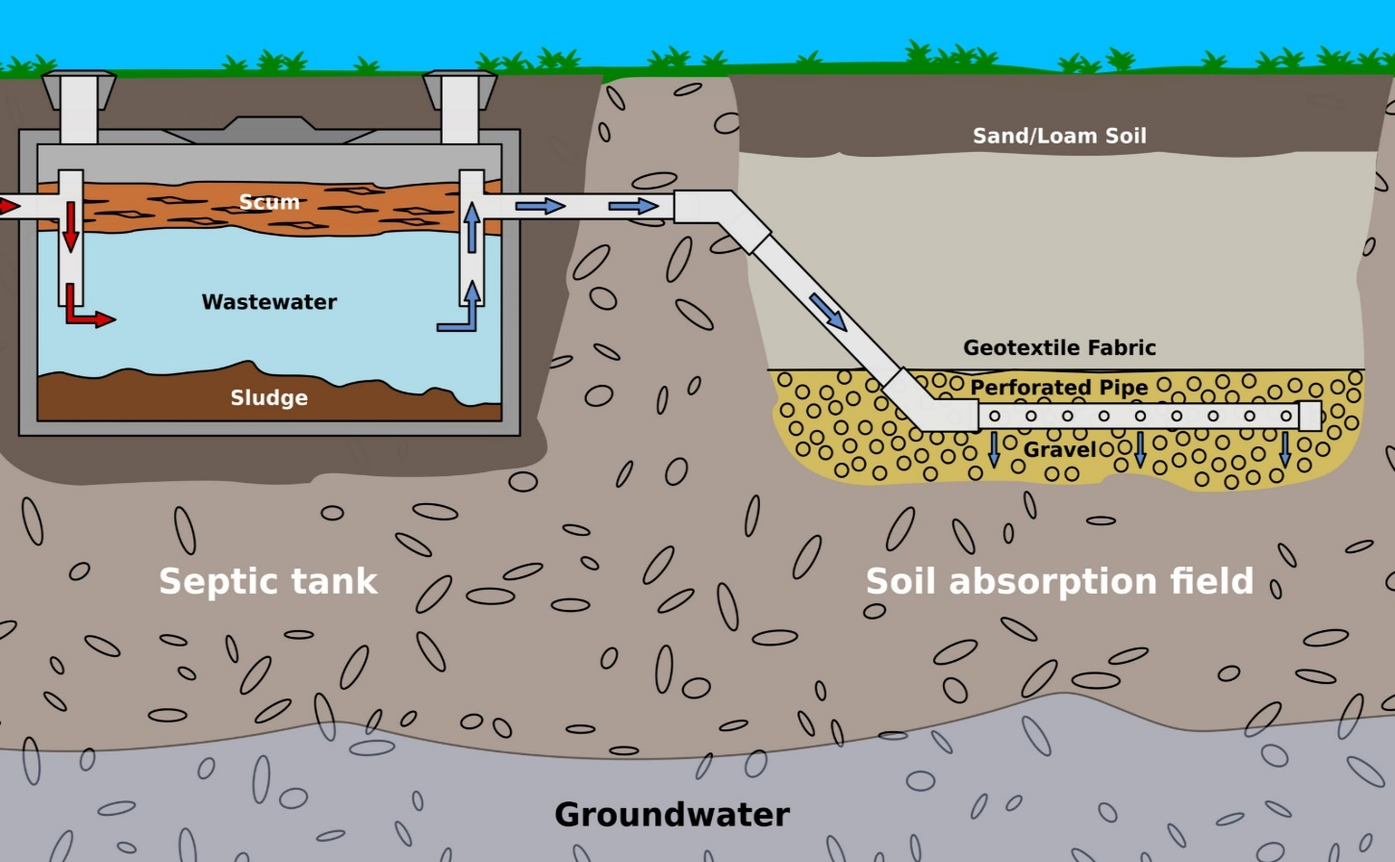
Septic Tank (Imhoff Tank)
Septic tanks are used as one of the common methods in wastewater treatment. These reactors, which are constructed in the form of vertical or horizontal cylinders in various diameters, are capable of easily removing suspended solids in wastewater during an appropriate retention time, thus reducing the pollution load of both soluble and insoluble contaminants in the wastewater.
Sewage Treatment System

Slide 7
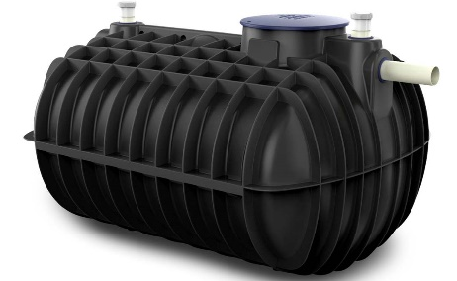
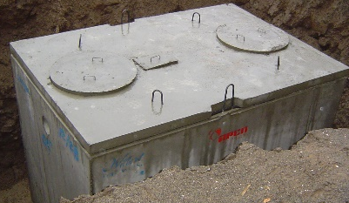
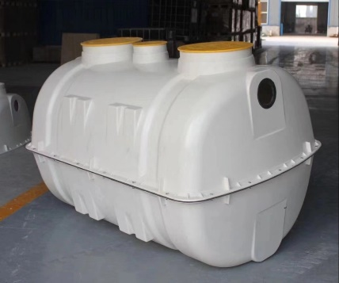
Advantages of Using Septic Tanks:
Execution Speed
Very reasonable cost
The treatment efficiency in this reactor is up to 50%
Solid removal up to 90% and removal of colloidal suspended solids up to 60%
Suitable for areas with a high water table or poor soil absorption capacity
No need for electrical or mechanical equipment, thus no requirement for daily maintenance and operation (operational management)
Can be used in coastal villas, residential towers, residential complexes, public services such as parks, factories, industrial complexes, and military bases
Polyethylene Septic Tank
Precast Concrete Septic Tank
Fiberglass Septic Tank
Sewage Treatment System
سیستم تصفیه فاضلاب

Slide 8
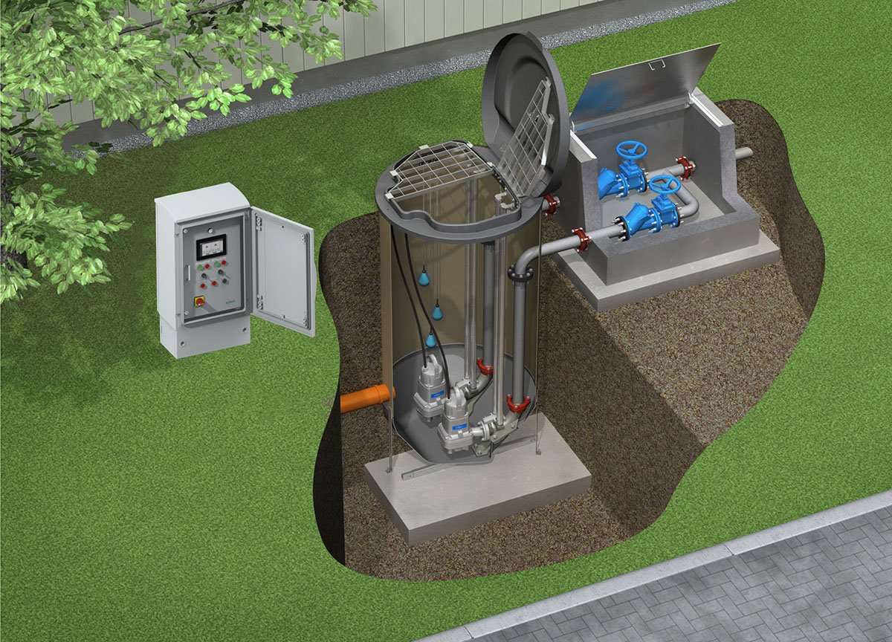
Pumping Station
Sewage Pumping Station is a reservoir used for transferring and relocating wastewater from lower areas to higher areas or towards wastewater treatment systems or urban patterns. These stations use powerful pumps to maintain the flow of wastewater in the sewage networks, preventing blockages and accumulation in the system.
Sewage Treatment System
سیستم تصفیه فاضلاب

Slide 9
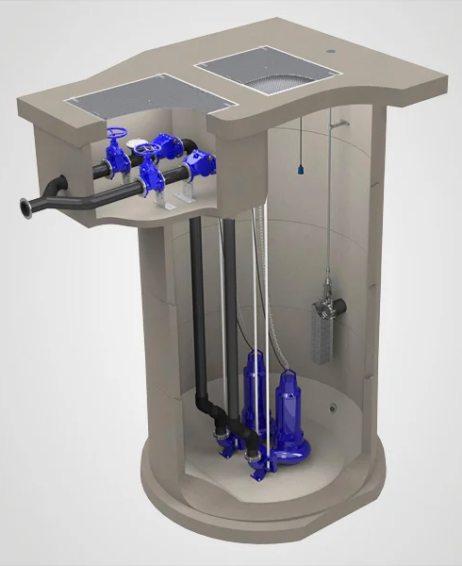
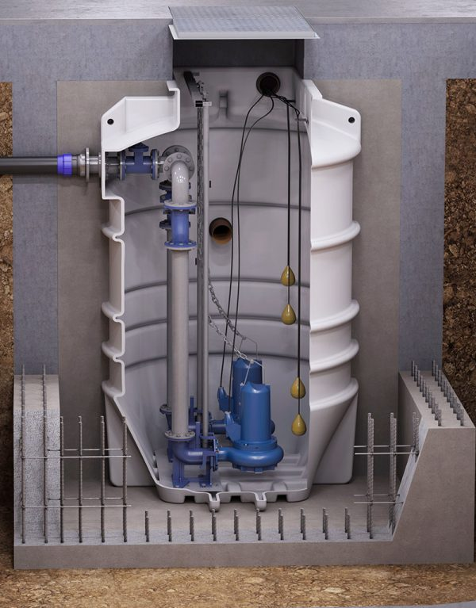
Advantages of Using a Sewage Pumping Station:
A sewage pumping station provides ease of installation for a sewage system and has the potential to reduce construction costs.
Wastewater is pumped automatically without human contact, eliminating the risk of health issues.
Various pump sizes are available for both residential and commercial applications. Pumps are often used to prevent blockages.
Wastewater can be automatically pumped to higher elevations.
The sewage pumping systems of this company are equipped with alarms to notify of system issues.
This quickly alerts to the risk of sewage overflow.
Concrete Pumping Station
Polyethylene Pumping Station
Sewage Treatment System
سیستم تصفیه فاضلاب

Slide 10
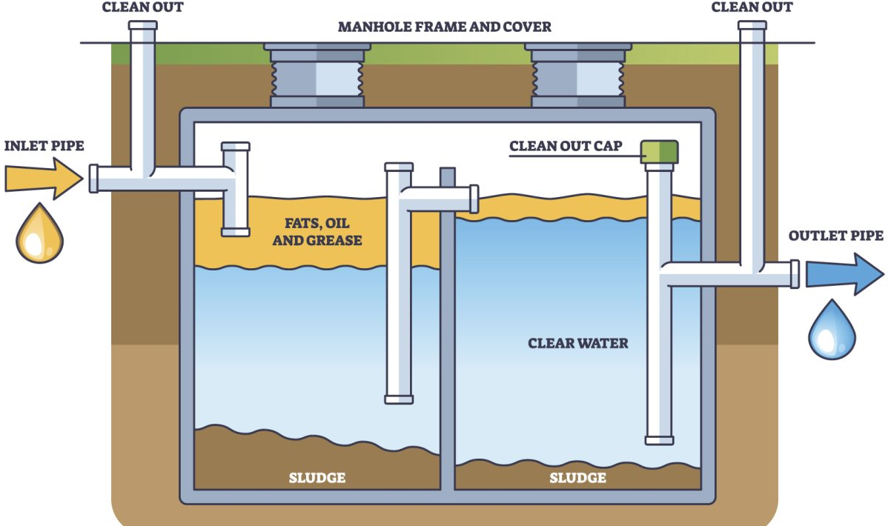
Grease Trap
A grease trap is a device used to separate and remove fats and oils from industrial and domestic wastewater. This device works by utilizing the density difference between fats and water to separate them from the wastewater, preventing their entry into the treatment system or the environment.
Sewage Treatment System
سیستم تصفیه فاضلاب

Slide 11
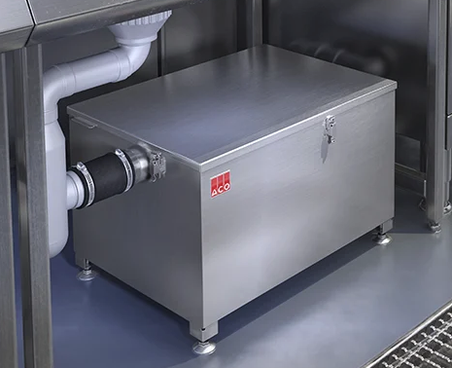
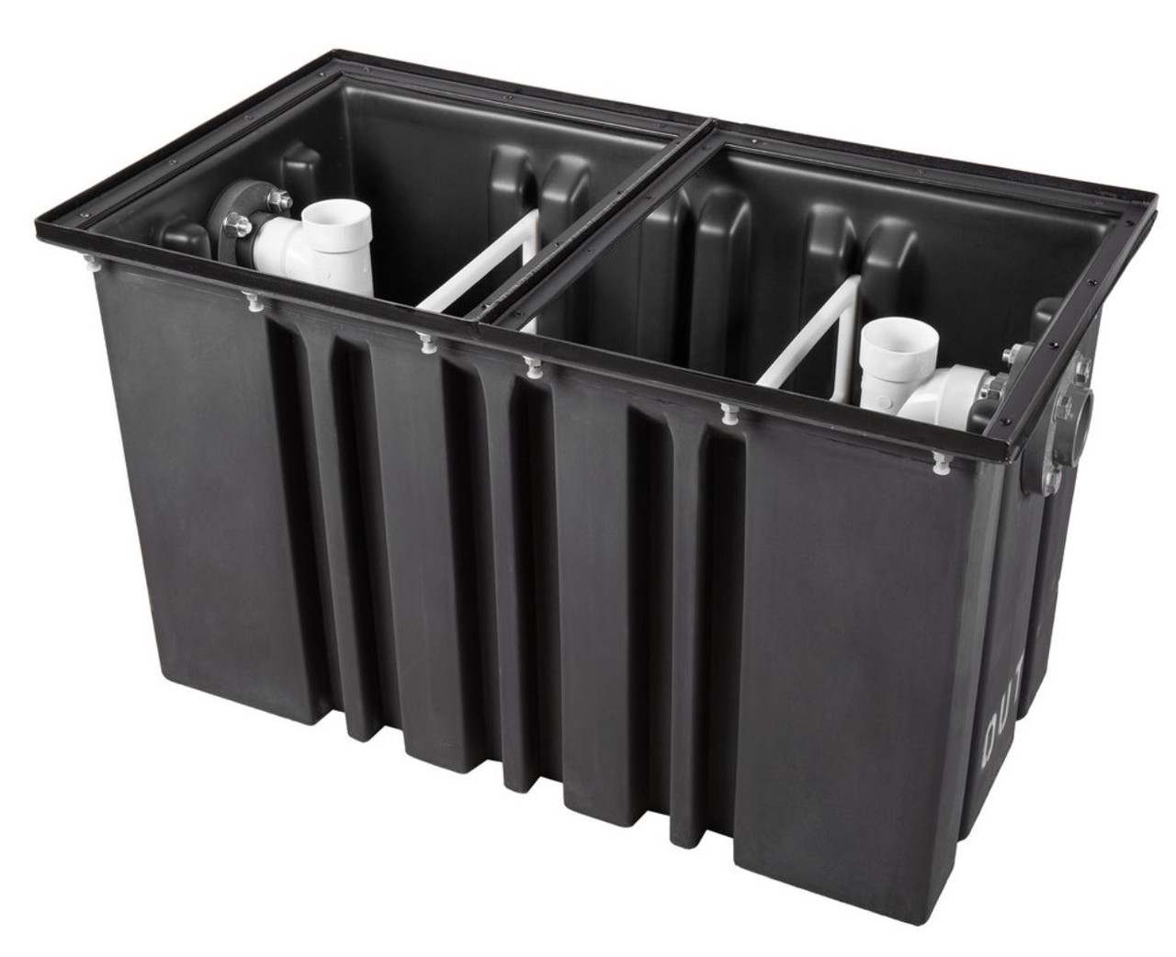
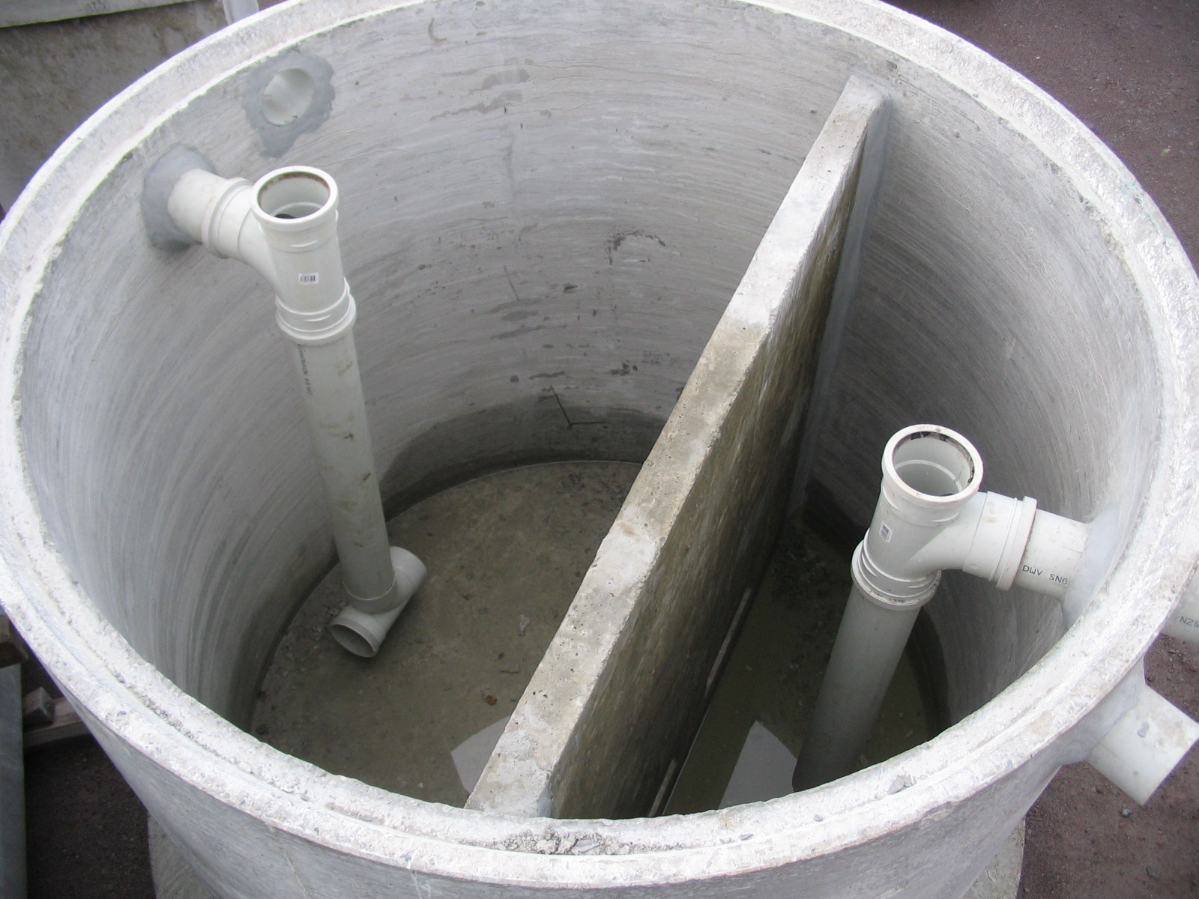
Advantages of Using a Grease Trap Device:
Ease of Installation and Setup
Collection and Discharge of Settling Solid Particles from the Bottom of the Tank
Ability to Remove Free Oil Particles
Low Energy Consumption
Low Maintenance and Repair Costs
High Shock Resistance to Accept Wastewater with Varying Flows
Automatic Collection of Fats and Oils from the Surface and Settled Materials from the Bottom
Under-Sink Grease Trap
Polyethylene Grease Trap
Concrete Grease Trap
Sewage Treatment System
سیستم تصفیه فاضلاب

Slide 12
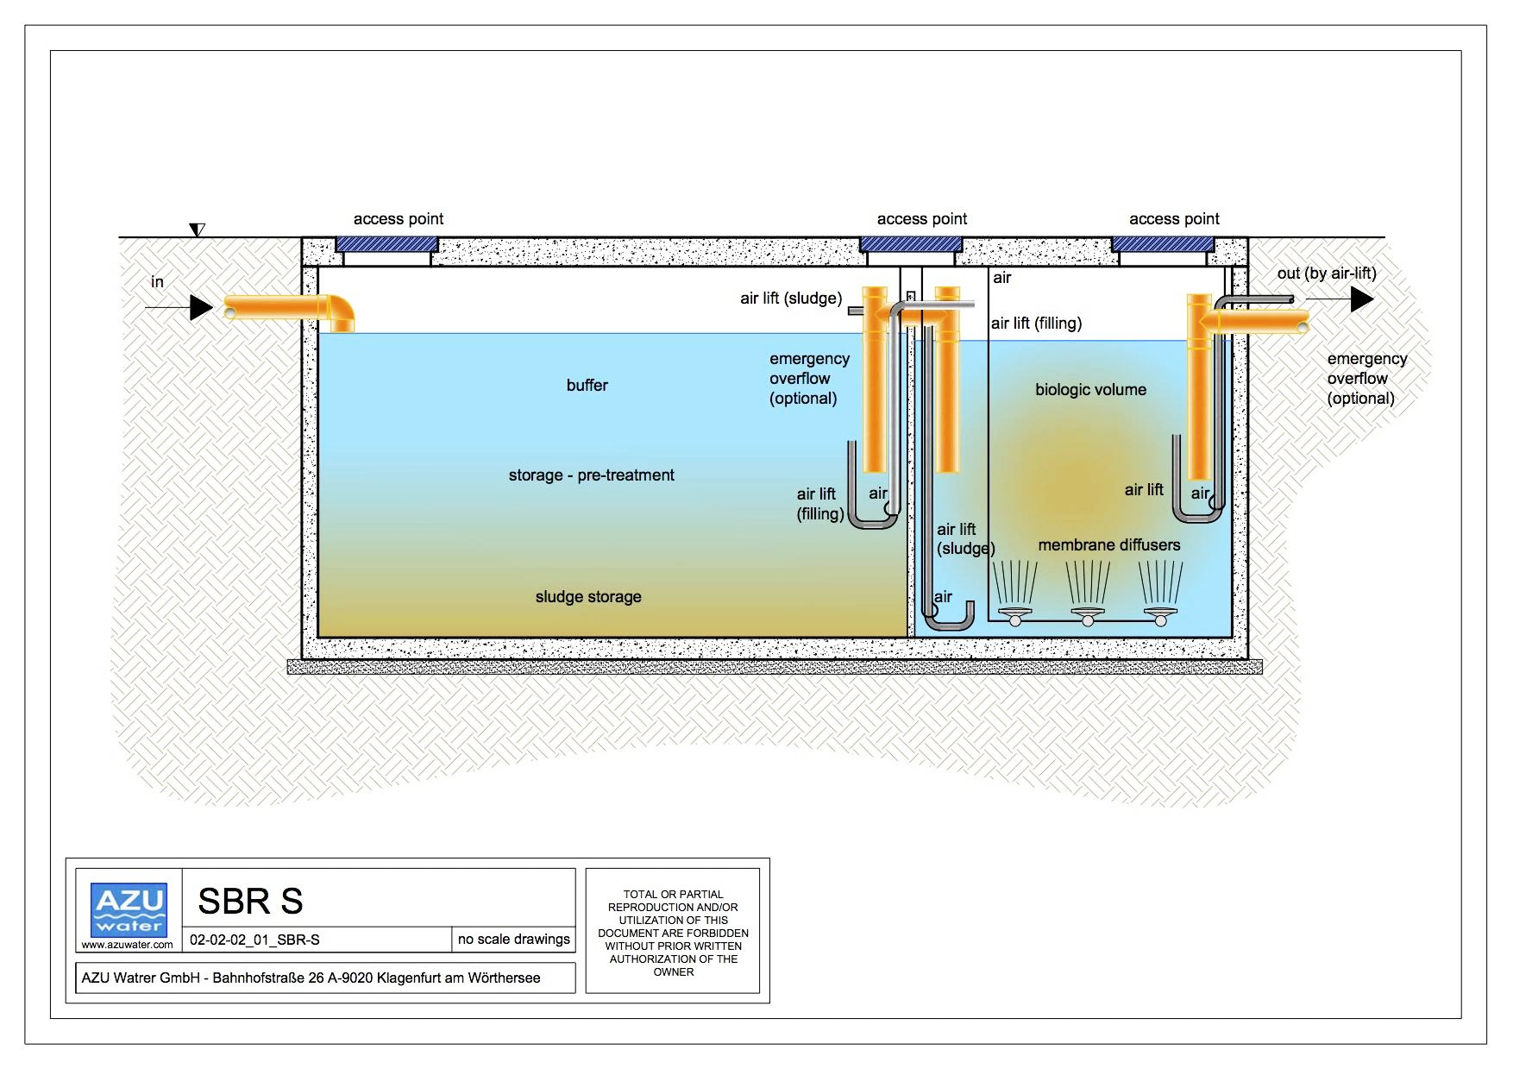
Aerobic Treatment by (ASBR Technology, Germany)
This system is offered with minimal ancillary costs and operational requirements, without any volume limitations. These packages, available in two models—one with polyethylene underground tanks for small volumes and the other with precast concrete tanks for large volumes—treat domestic wastewater and are capable of meeting all environmental standards for the reuse of treated water.
Sewage Treatment System
سیستم تصفیه فاضلاب

Slide 13
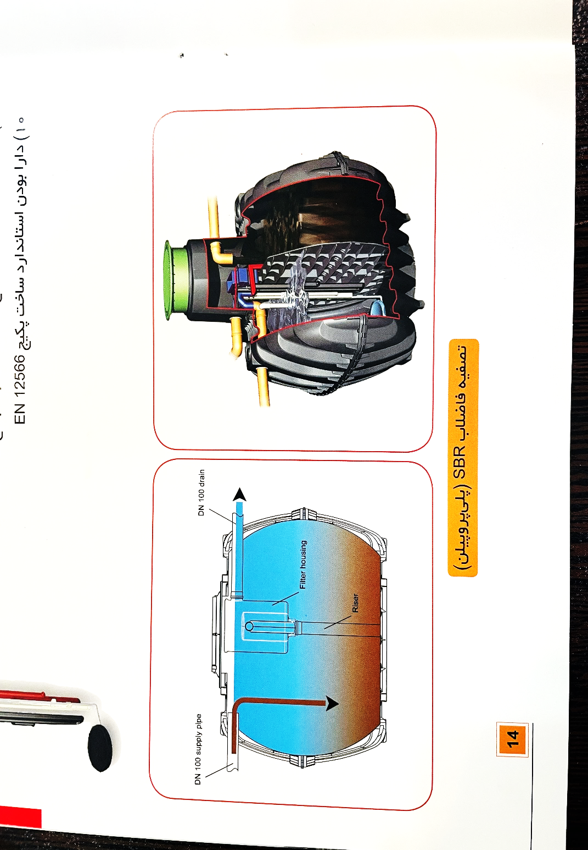
Advantages of Using the ASBR Wastewater Treatment System:
Space-Efficiency and Aesthetic: Due to the buried nature of the tanks, there is no space occupation or unsightly view, and the system can withstand traffic loads.
Elimination of Sewage Pump: By utilizing Airlift technology for wastewater transfer, the system significantly reduces electricity consumption, noise, and maintenance costs.
Odor Control: No unpleasant odors are emitted in the area due to the high efficiency of the package and the airtight design of the tanks.
Suitable for All Climates: The tanks are watertight, making the system suitable for any climate.
No Operator Needed: The system operates without the need for an operator, thanks to the intelligent board with monitoring capabilities.
High-Quality Effluent: The system produces effluent that meets all environmental standards.
Direct Use for Irrigation: The treated water can be used directly for irrigation of green spaces, etc.
Smart Detection: The system can intelligently detect low load and input shock, managing them effectively.
Modular Design: It is modular, allowing for the removal of one or more packages from the system if necessary.
Compliance with Standards: The package construction complies with the EN 1256 manufacturing standard.
Sewage Treatment System
سیستم تصفیه فاضلاب

Slide 14
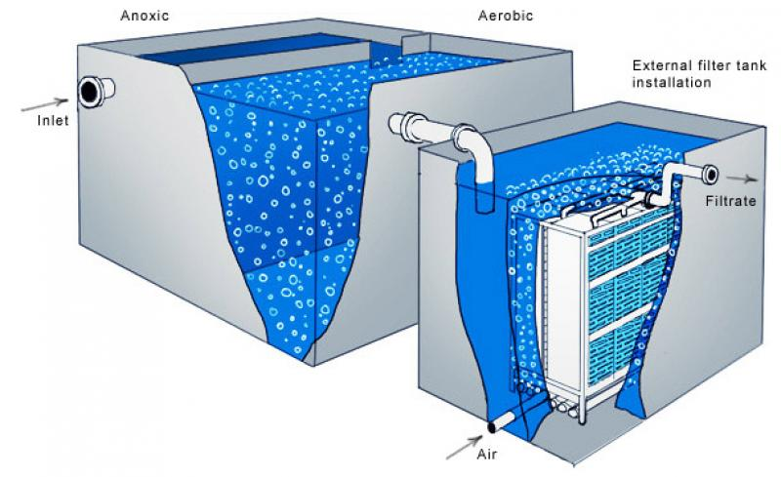
Wastewater Treatment by the MBBR Method (Moving Bed Biofilm Reactor)
The MBBR (Moving Bed Biofilm Reactor) system is an advanced wastewater treatment technology that uses suspended biofilm carriers to create a biological bed for microorganism growth. These microorganisms are responsible for breaking down the organic materials present in the wastewater. The MBBR system is highly regarded in water and wastewater treatment processes due to its high efficiency and flexibility in measurement and design.
Sewage Treatment System
سیستم تصفیه فاضلاب

Slide 15
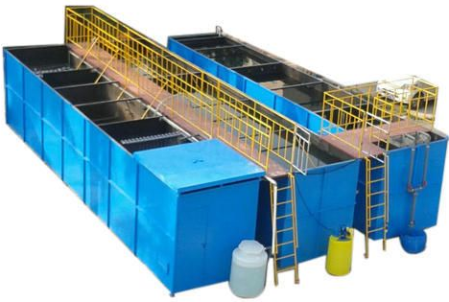
Advantages of Using the MBBR Wastewater Treatment System:
High Treatment Capacity: The MBBR system is capable of treating wastewater at higher volumes, making it suitable for systems with high pollution loads. Due to the use of suspended biofilm carriers, the surface area for microorganism growth is increased.
Design Flexibility: This system can be designed in various scales (from small to large) and can be used for different wastewater treatment needs across various industries.
No Need for Complex Pre-treatment: The MBBR system typically does not require complex pre-treatment processes like sand filters or grease traps, as it is effective in removing organic materials on its own.
Reduced Space Requirements: Due to the use of suspended carriers, the MBBR system requires less space compared to other treatment systems, such as activated sludge systems, as the biological contact area is greater.
Flexibility in Pollution Load: The system can efficiently handle variations in pollution load and wastewater volume, maintaining effective performance even under changing conditions.
Sewage Treatment System
سیستم تصفیه فاضلاب

Slide 16
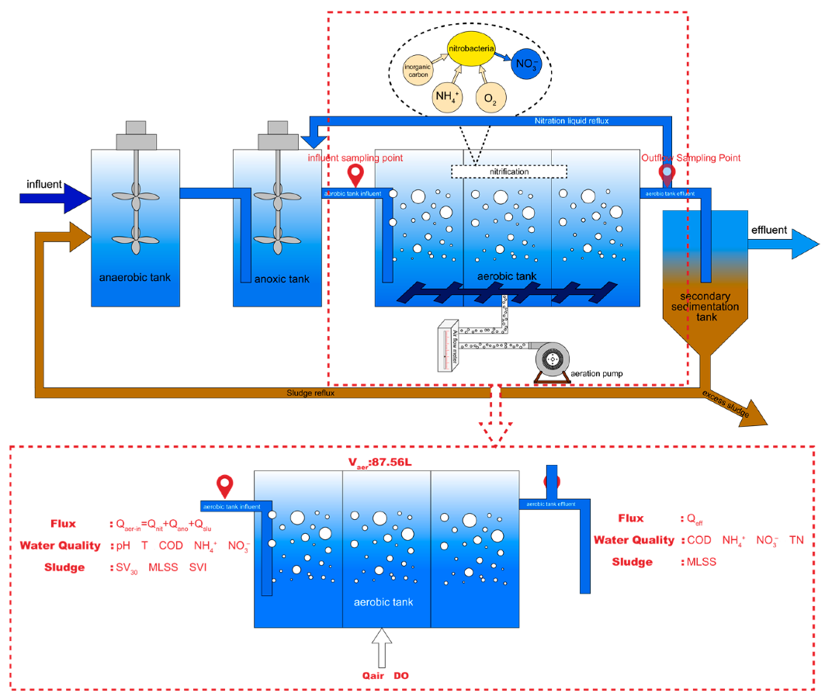
Wastewater Treatment by the A2O Method (Anaerobic, Anoxic, and Oxic Process)
The A2O process uses different biological stages to remove organic materials, nitrogen, and phosphorus. This system is primarily used for treating wastewater containing nitrogenous and phosphorous compounds. The A2O process is specifically designed to reduce the biological pollution load, nitrogen, and phosphorus in wastewater and is recognized as one of the most effective methods for wastewater treatment.
Sewage Treatment System
سیستم تصفیه فاضلاب

Slide 17
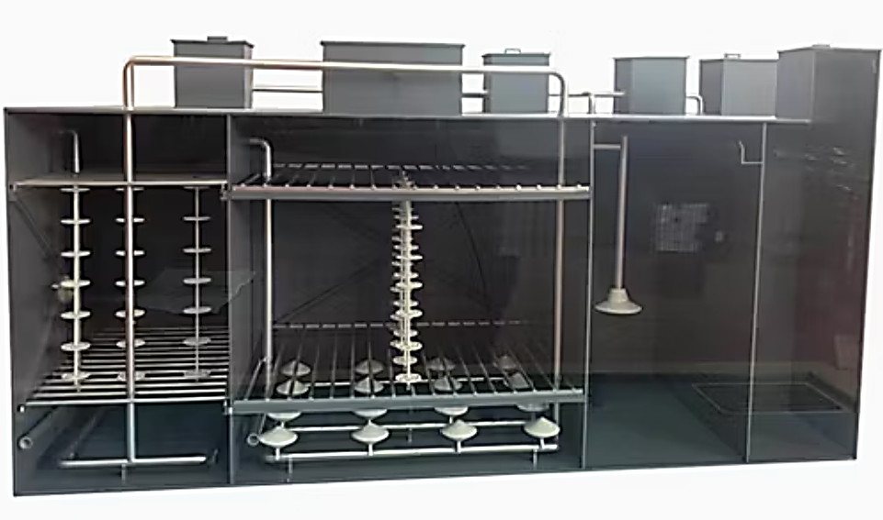
Advantages of Using the A2O Wastewater Treatment System:
Effective Removal of Nitrogen and Phosphorus: One of the main advantages of the A2O system is its effective removal of phosphorus from wastewater. The anaerobic stage in this system allows microorganisms to absorb phosphorus, reducing its concentration in the wastewater.
Reduced Sludge Volume: The A2O system reduces sludge production due to the use of anaerobic processes. In this process, the breakdown of organic materials is more efficient, leading to a reduction in the volume of generated sludge.
High-Quality Effluent: After completing the various stages in the A2O system, the treated effluent has a higher quality, with nitrogen and phosphorus levels minimized.
Flexibility in Pollution Load: This system can effectively handle variations in pollution load and wastewater volume, maintaining efficient performance even under changing conditions.
Sewage Treatment System
سیستم تصفیه فاضلاب

Slide 18
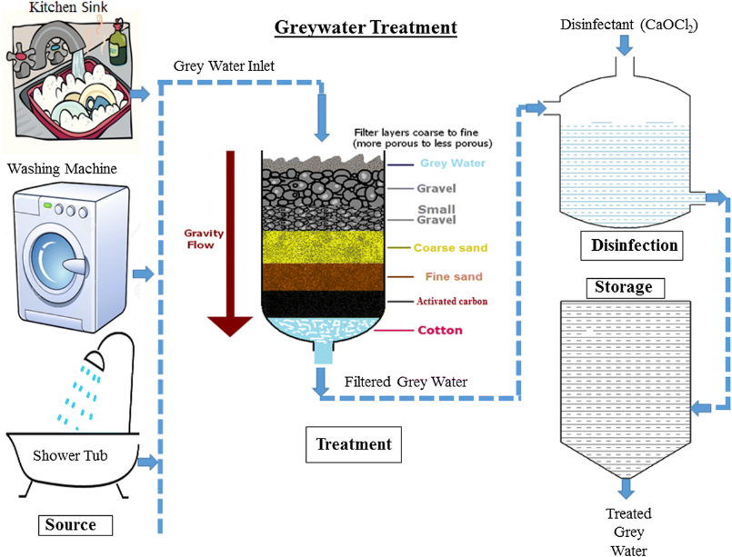
Gray Water Treatment
Graywater is water that comes from household activities such as showering, dishwashing, and laundry, and it makes up a significant portion of the total wastewater produced in a home. By treating and reusing this water, substantial savings in drinking water consumption can be achieved, while also reducing the pressure on urban sewage systems. This approach not only helps conserve water resources but also has positive environmental impacts. In fact, graywater accounts for 80% of the total household wastewater, which is a significant amount.
Sewage Treatment System
سیستم تصفیه فاضلاب

Slide 19
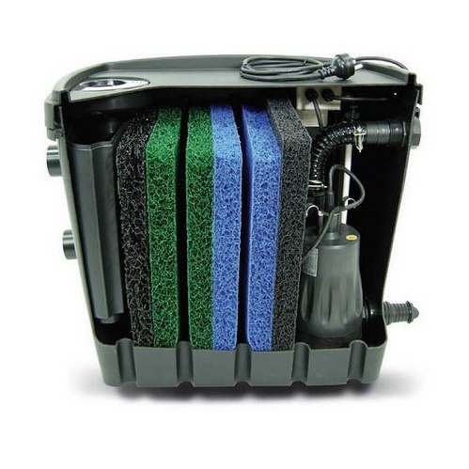
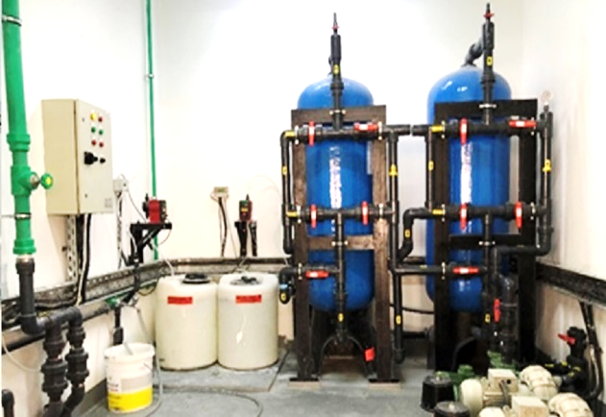
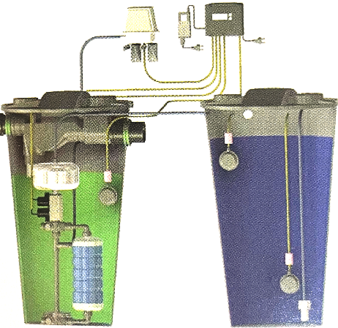
Advantages of Using Gray Water:
Reduced Fresh Water Consumption
Less Pressure on Urban Sewage Systems
Suitable for Areas with Inadequate Blackwater Collection and Treatment
Lower Energy and Chemical Use
Groundwater Recharge
Environmental Protection
Economic and Social Sustainability
Filtration Package
Combined Sand Filtration and Chlorination Method
AQUALOOP
Sewage Treatment System
سیستم تصفیه فاضلاب

Slide 20
Water Treatment Systems

Slide 21
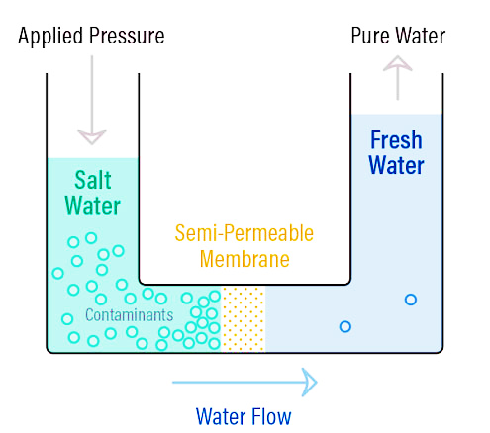
Water Treatment Device (Reverse Osmosis Water Desalination System)
It is used for desalinating very salty, brackish, and other types of water.
In reverse osmosis water purification, raw (untreated) water is pumped into a chamber containing a semi-permeable membrane under pressure. Since only pure water can pass through the membrane, almost pure water forms on one side of the membrane, while the concentrated water with impurities forms on the other side. The external pressure applied is higher than the natural osmotic pressure, allowing smaller molecules to pass through the membrane’s pores, while larger molecules are unable to pass. It should be noted that the pore size of a membrane is even smaller than the size of a virus or bacterium. Larger molecules are pushed along the membrane and discarded in the process.
Water Treatment Systems
سیستم های تصفیه آب

Slide 22
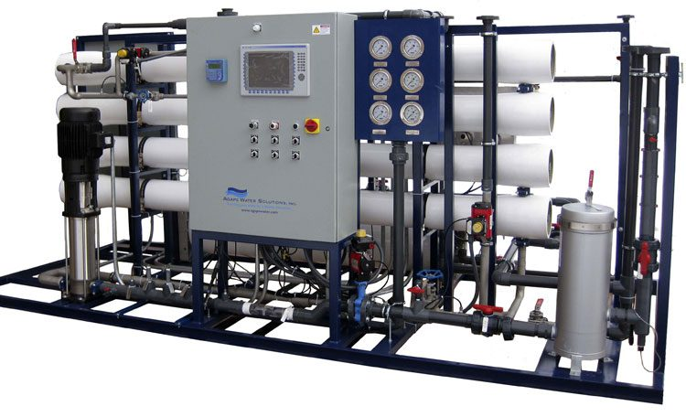
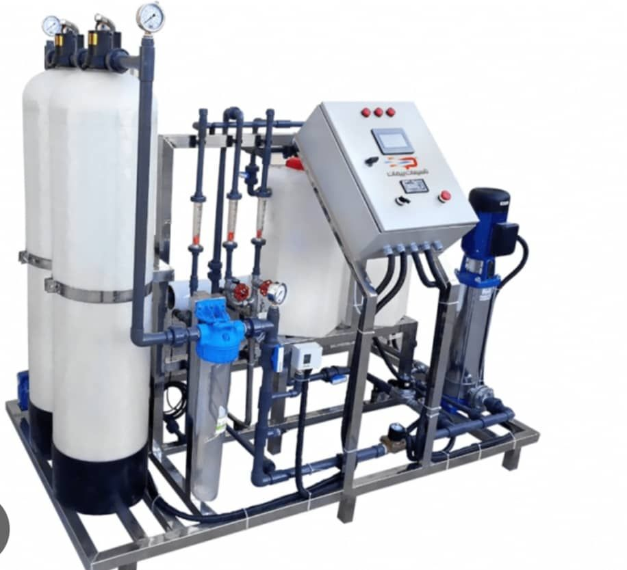
Advantages of Using a Reverse Osmosis (RO) Water Desalination System:
Provision of suitable water based on usage type (drinking, all food industries, pharmaceuticals, agriculture, etc.)
Removal of all salts in water by approximately 90%
Provision of suitable water from any source or input
Cost-effectiveness of the system compared to other methods, with lower energy consumption
Continuous operation without the need for periodic shutdowns
Ease of operation with the device
Reduction in maintenance and repair costs
Water Treatment Systems
سیستم های تصفیه آب

Slide 23
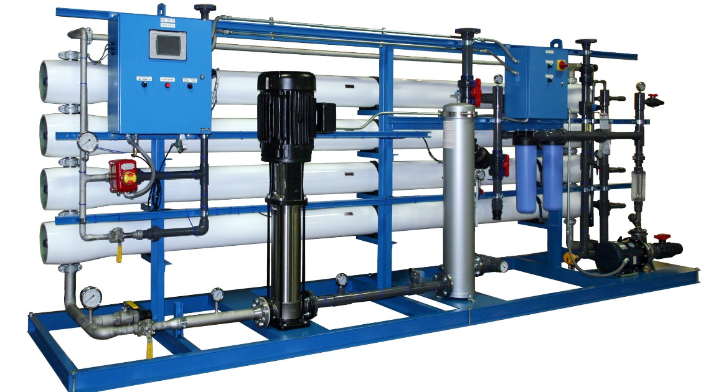
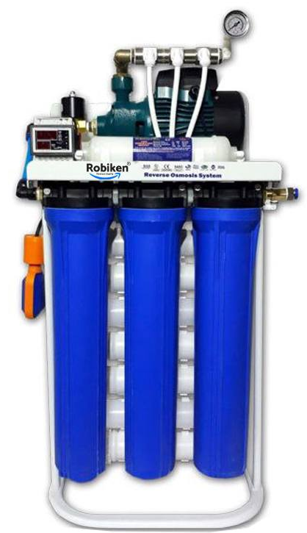
Types of Reverse Osmosis (RO):
Industrial
Semi-industrial
Household
Water Treatment Systems
سیستم های تصفیه آب

Slide 24
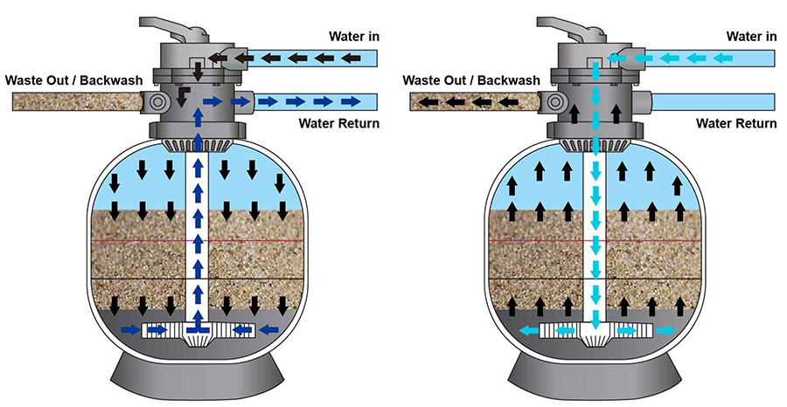
Sand Filter
Sand Filters a device used for water treatment, consisting of a tank (containing clean sand or gravel) made from steel, concrete, fiberglass, or polyethylene FRP, which is designed in cylindrical or cubic shapes. It physically removes solid and suspended particles, silt, and biological suspended particles up to 50 microns. Sand filters are among the most commonly used equipment for filtering suspended impurities in water.
Water Treatment Systems
سیستم های تصفیه آب

Slide 25
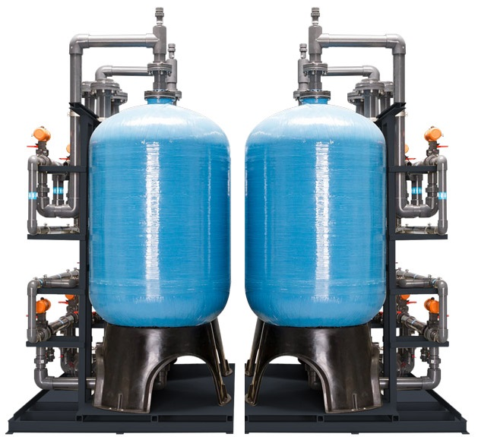
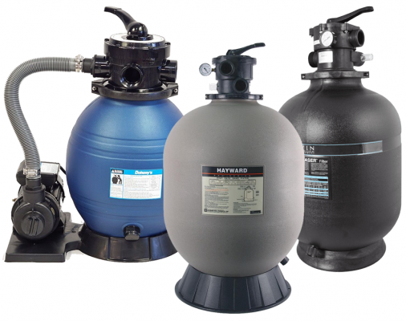
Types of Sand Filters:
Resin Sand Filter
Galvanized Sand Filter
Vertical Sand Filter
Horizontal Sand Filter
Standing Sand Filter
Aquarium Sand Filter
Boiler Sand Filter
Jacuzzi Sand Filter
Water Treatment Systems
سیستم های تصفیه آب

Slide 26
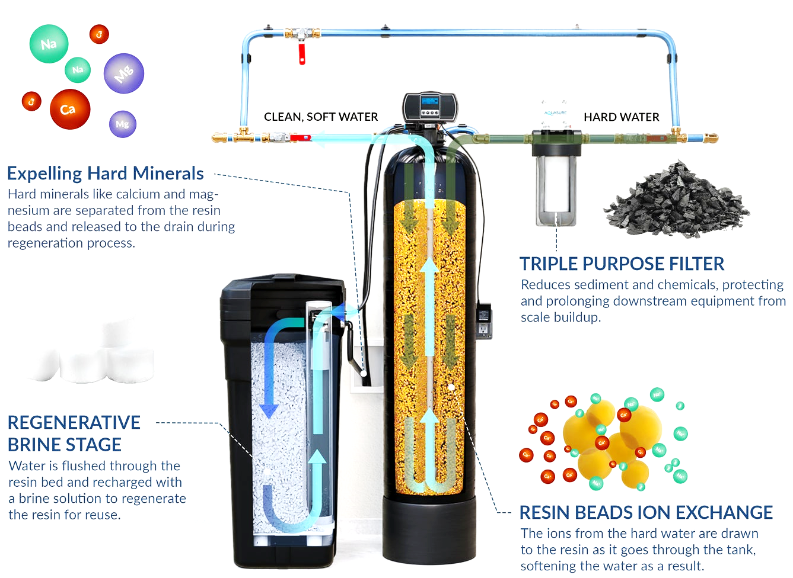
water softener
Water Softener is a device that passes hard water containing minerals through resin under pressure, separating the softened water and removing its hardness. This device is used to remove the hardness of water, including calcium, magnesium, and some metallic cations found in hard water. In other words, it creates a favorable environment within a pressure vessel made of metal (galvanized) or fiberglass (FRP), facilitating ion exchange. Factors such as water flow rate, desired water hardness, and backwash time are key considerations in designing a resin-based water softener with an appropriate capacity.
Water Treatment Systems
سیستم های تصفیه آب

Slide 27
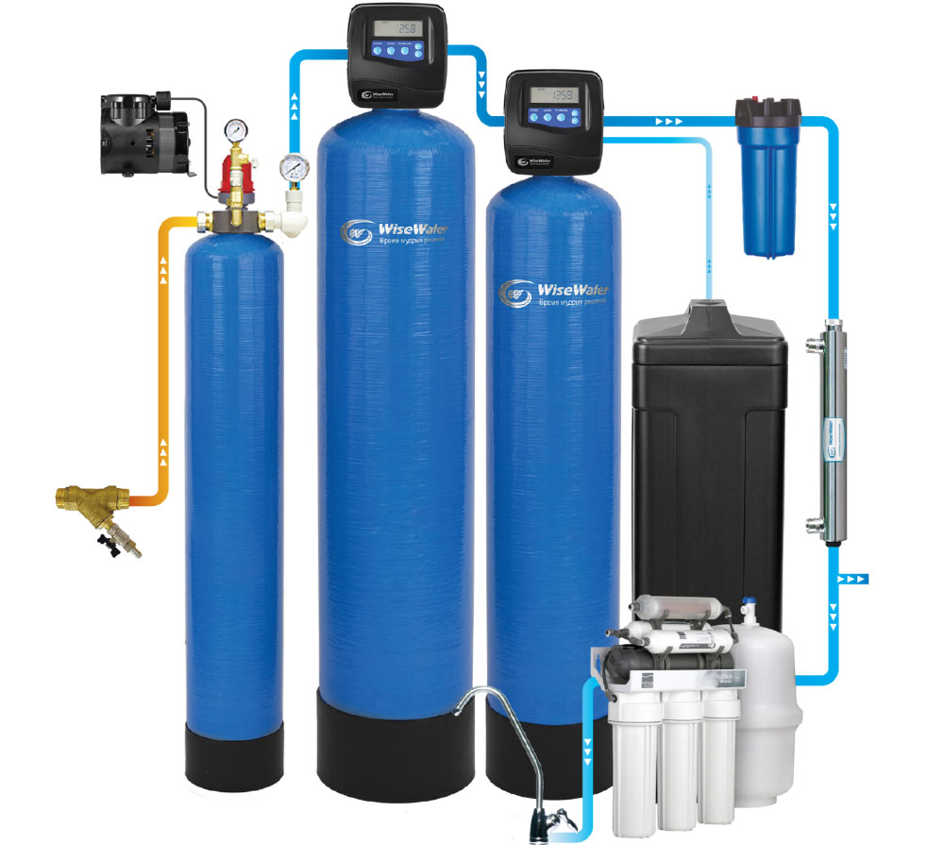
Advantages of Using a Water Softener:
Increased Efficiency of Household Appliances and Plumbing System
Reduced Energy Consumption Costs
Lower Consumption of Cleaning Products
Prevention of White Stains on Clothes and Surfaces
Maintains Hair Health and Shine After Bathing
High-Thickness Epoxy Coating (at least 120 microns) Used to Increase Package Lifespan and Protect Against Damage and Corrosion (in metal body tanks)
Water Distribution System for Even Water Flow and Improved Efficiency
Resin Bed with High Ion Exchange Capacity, Quick Regeneration, and Low Pressure Drop
Polyethylene Salt Tank and Suitable Piping for Solution Suction
Water Treatment Systems
سیستم های تصفیه آب

Slide 28
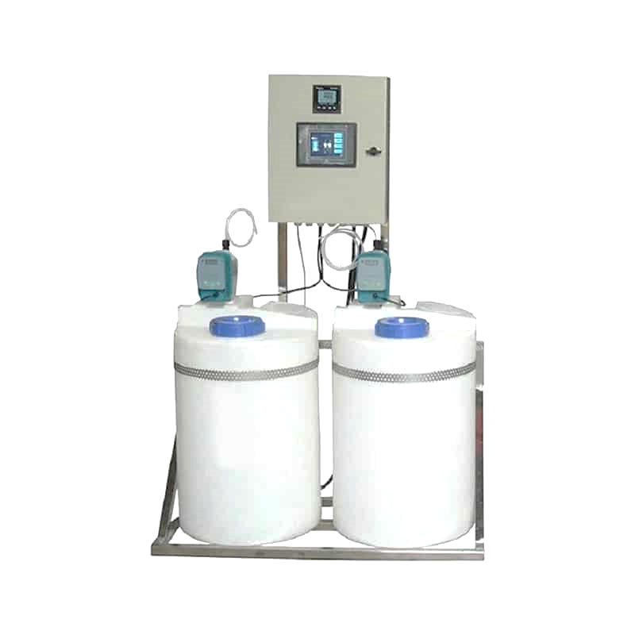
Chlorination Package
Chlorination Package is a device used for disinfecting water with chlorine (gas or chlorine solution). This system typically includes a chlorine tank, injection pump, and control equipment that automatically adjusts the required chlorine dosage based on the volume and quality of the water. These packages are used in desalination plants, water treatment plants, and various industries to eliminate microbes and microbial contaminants.
Water Treatment Systems
سیستم های تصفیه آب

Slide 29
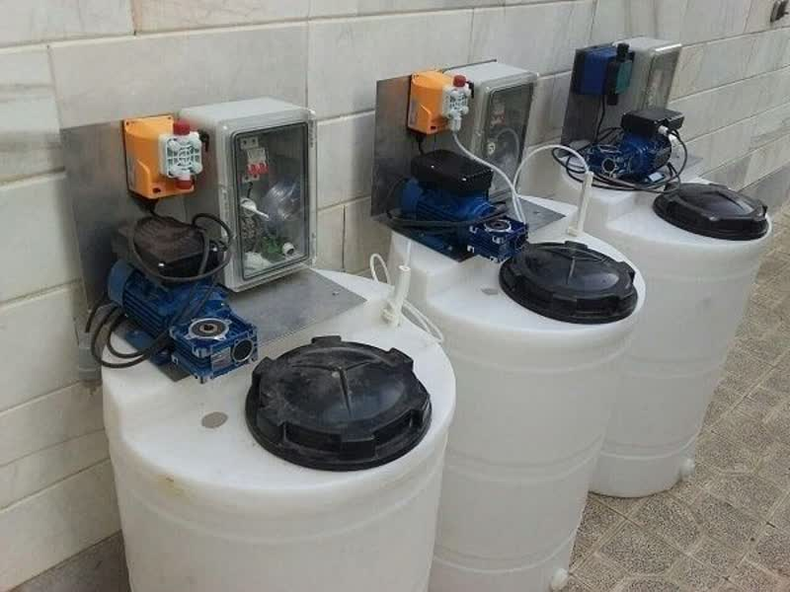
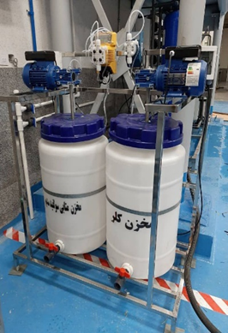
Advantages of Using a Chlorination Package:
Reduction of Microbial Contaminants: Chlorination eliminates bacteria, viruses, and other harmful microorganisms in water, helping to improve water quality and safety.
Long-Lasting Disinfection Effects: In addition to immediate disinfection, chlorine maintains its antimicrobial effects in the water for a long time, preventing the regrowth of bacteria.
Low Cost and High Efficiency: Chlorine is one of the most affordable and effective disinfectants for water, minimizing operational costs in water treatment systems.
Ease of Implementation and Use: Chlorination systems are easy to set up and control, automatically providing the appropriate chlorine dosage based on water requirements.
Water Treatment Systems
سیستم های تصفیه آب

Slide 30
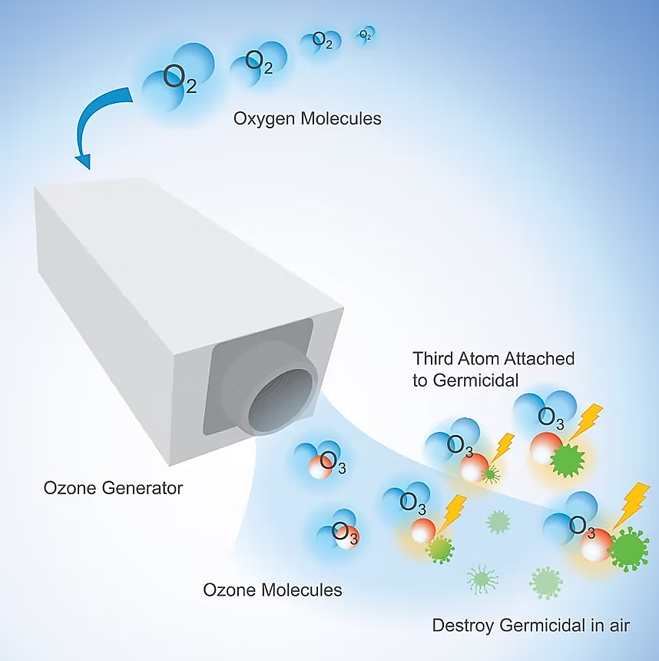
Ozone Generator
Ozone Generator is a device that uses electrical energy to break down oxygen (O₂) molecules and convert them into ozone (O₃). The generated ozone acts as a powerful oxidizer and disinfectant. These devices are commonly used for disinfecting water, air, and surfaces in various industries and facilities.
Water Treatment Systems
سیستم های تصفیه آب

Slide 31
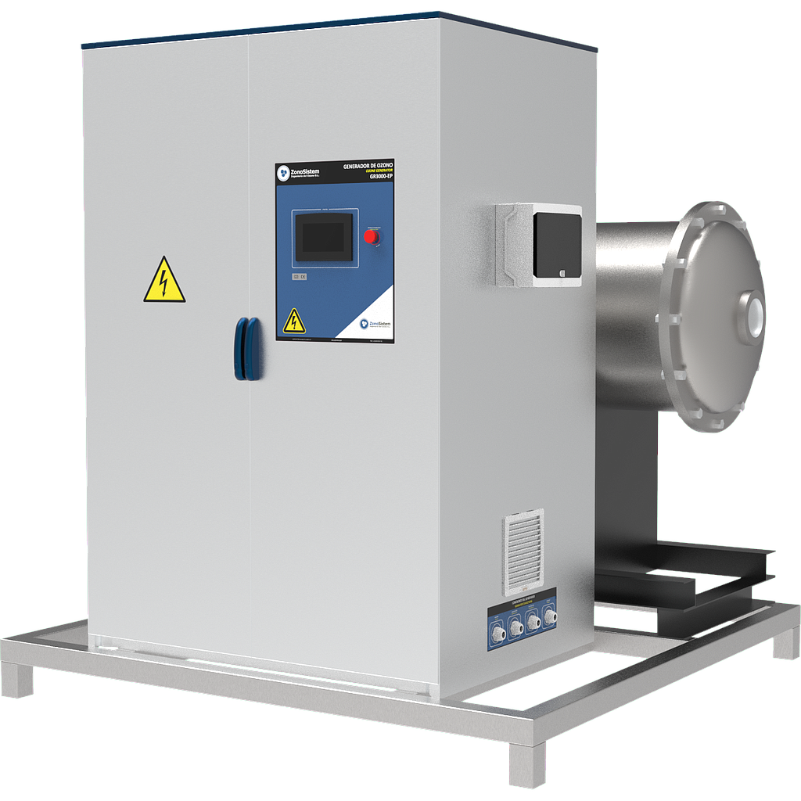
Advantages of Using an Ozone Generator:
Powerful and Fast Disinfection: Ozone is one of the strongest disinfectants in the world, more powerful than chlorine, and can destroy viruses, bacteria, and molds in a very short time.
No Harmful Chemical Residues: Unlike many chemical disinfectants, ozone quickly converts back to ordinary oxygen (O₂) after disinfection, leaving no toxic residues behind.
Reduced Chemical Consumption: Using an ozone generator significantly reduces reliance on chemicals like chlorine and its compounds, leading to cost savings and greater environmental protection.
Multiple Applications: These devices can be used in various fields, including water and wastewater treatment, air disinfection for rooms, food preservation, and surface sterilization.
Water Treatment Systems
سیستم های تصفیه آب

Slide 32
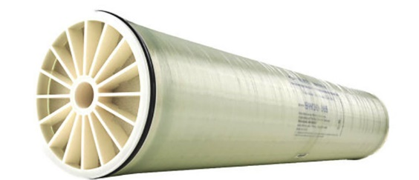
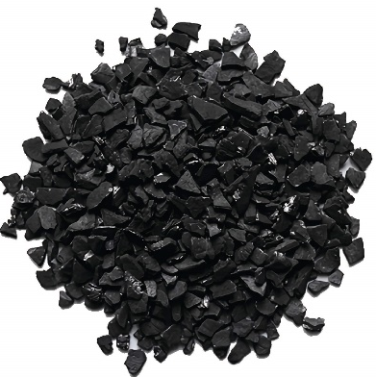
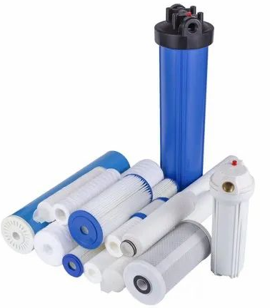
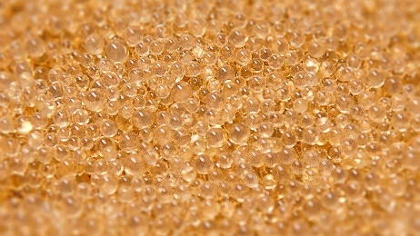
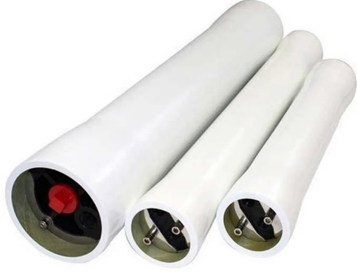

Water Treatment Equipment
Cartridges Types
Membranes
Types of Resins
Activated Carbon
Graded Silica
Types of UV (Ultraviolet) Systems
Types of Brush Rolls
FRP (Fiberglass Reinforced Plastic) Tanks
Types of High-Pressure Pumps
Types of Chemicals (Chlorine, Metabisulfite, Antiscalant, System Cleaning Agents, etc.)
Water Treatment Systems
سیستم های تصفیه آب

Slide 33

Web: WWW.GW-company.com
WWW.GW-company.ir
Email: info@GW-company.com
Admin@GW-company.com
Contact us: +982144455965
+989124173691
+989122148067
Water Treatment Systems
سیستم های تصفیه آب

